Slide 1
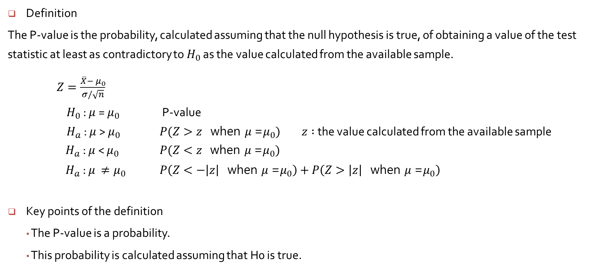
P-Values
Definition
The P-value is the probability, calculated assuming that the null hypothesis is true, of obtaining a value of the test statistic at least as contradictory to $H_{0}$ as the value calculated from the available sample.
$Z=\frac{\overline{X}−{ μ}_{0}}{σ/\sqrt{n}}$
$H_{0}$ : $μ$ = $μ_{0}$ P-value
$H_{a}$ : $μ$ > $μ_{0}$ $P(Z>z \text{when} μ \text{=}μ_{0})$ $z :$the value calculated from the available sample
$H_{a}$ : $μ$ < $μ_{0}$ $P(Z<z \text{when} μ \text{=}μ_{0})$
$H_{a}$ : $μ { ≠μ}_{0}$ $P\left(Z<−\left|z\right| \text{when} μ \text{=}μ_{0}\right)+P\left(Z>\left|z\right| \text{when} μ \text{=}μ_{0}\right)$
Key points of the definition
The P-value is a probability.
This probability is calculated assuming that H0 is true.

Slide 2
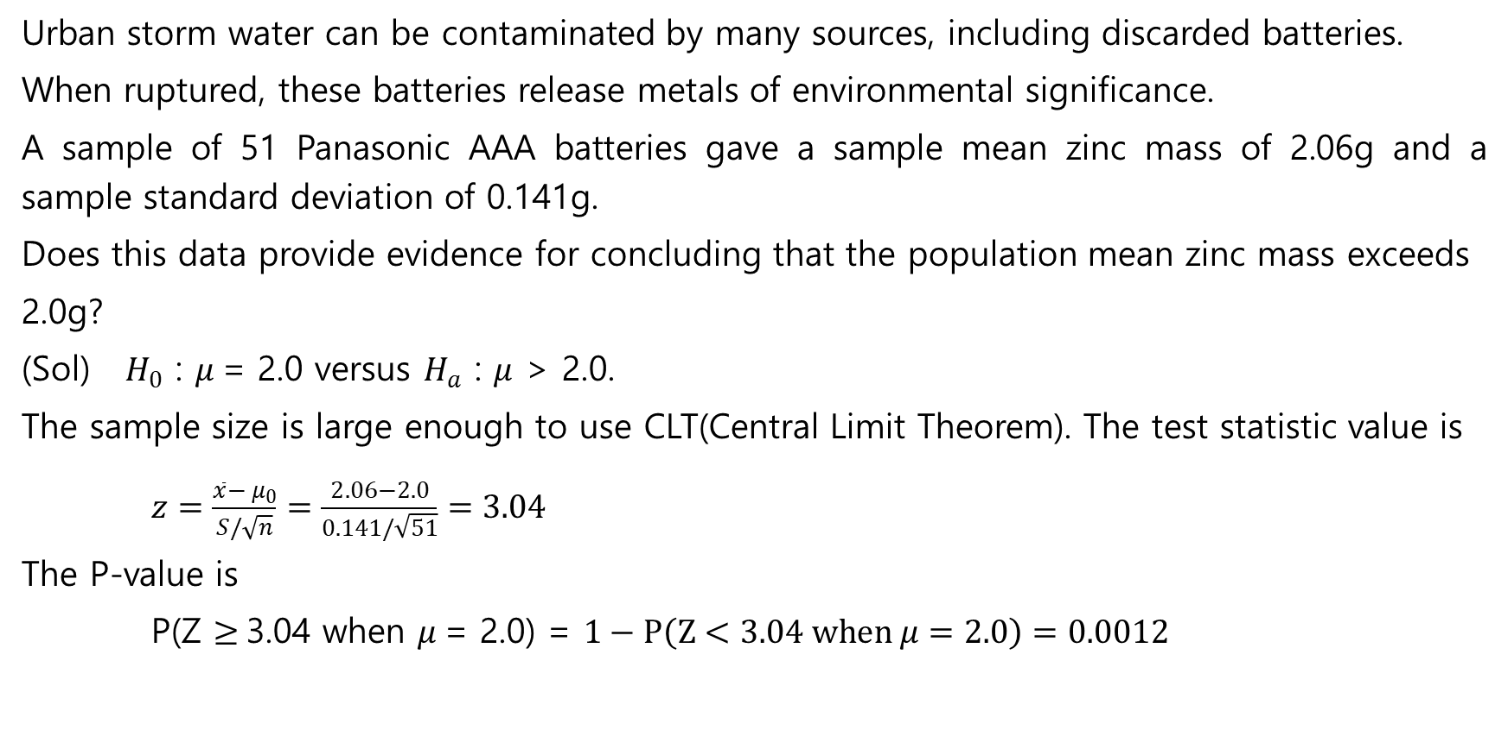
P-Values : Example 8.14
Urban storm water can be contaminated by many sources, including discarded batteries.
When ruptured, these batteries release metals of environmental significance.
A sample of 51 Panasonic AAA batteries gave a sample mean zinc mass of 2.06g and a sample standard deviation of 0.141g.
Does this data provide evidence for concluding that the population mean zinc mass exceeds
2.0g?
(Sol) $H_{0}$ : $μ$= 2.0 versus $H_{a}$ : $μ$ > 2.0.
The sample size is large enough to use CLT(Central Limit Theorem). The test statistic value is
$z=\frac{\overline{x}−{ μ}_{0}}{S/\sqrt{n}}=\frac{2.06−2.0}{0.141/\sqrt{51}}=3.04$
The P-value is
P(Z $≥$3.04 when $μ$= 2.0) = $1−P\left(Z<3.04 when μ=2.0\right)=0.0012$

Slide 3
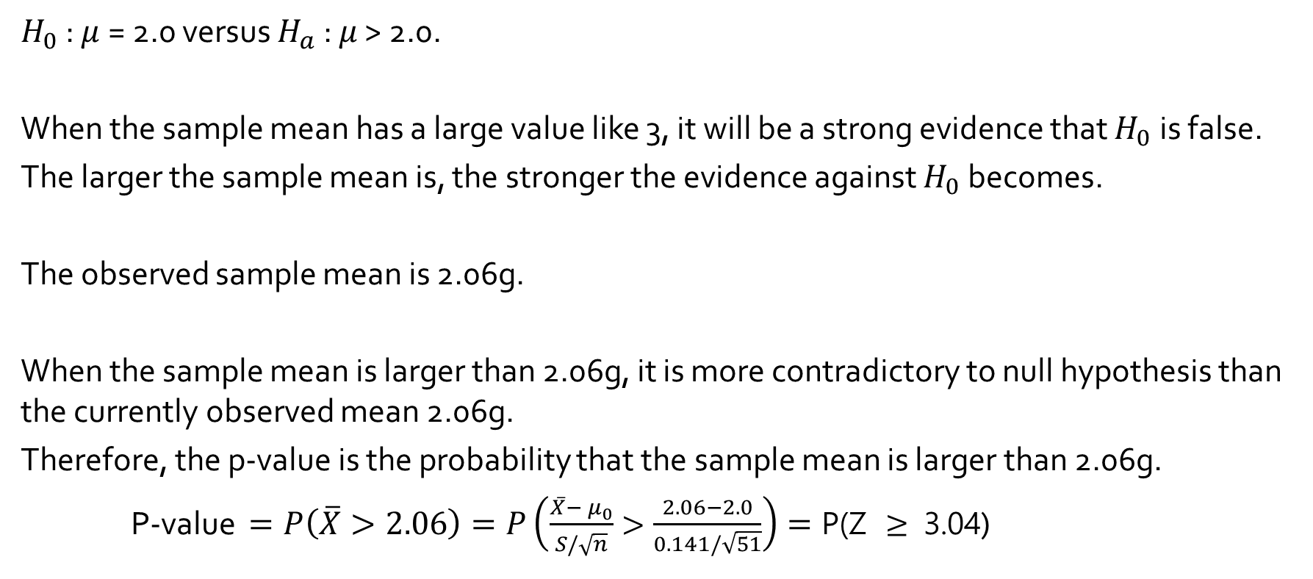
P-Values : Example 8.14
$H_{0}$ : $μ$= 2.0 versus $H_{a}$ : $μ$ > 2.0.
When the sample mean has a large value like 3, it will be a strong evidence that $H_{0}$ is false.
The larger the sample mean is, the stronger the evidence against $H_{0}$ becomes.
The observed sample mean is 2.06g.
When the sample mean is larger than 2.06g, it is more contradictory to null hypothesis than the currently observed mean 2.06g.
Therefore, the p-value is the probability that the sample mean is larger than 2.06g.
P-value $=P\left(\overline{X}>2.06\right)=P\left(\frac{\overline{X}−{ μ}_{0}}{S/\sqrt{n}}>\frac{2.06−2.0}{0.141/\sqrt{51}}\right)=\text{P}\text{(}\text{Z} ≥ \text{3}\text{.}\text{04}$)

Slide 4
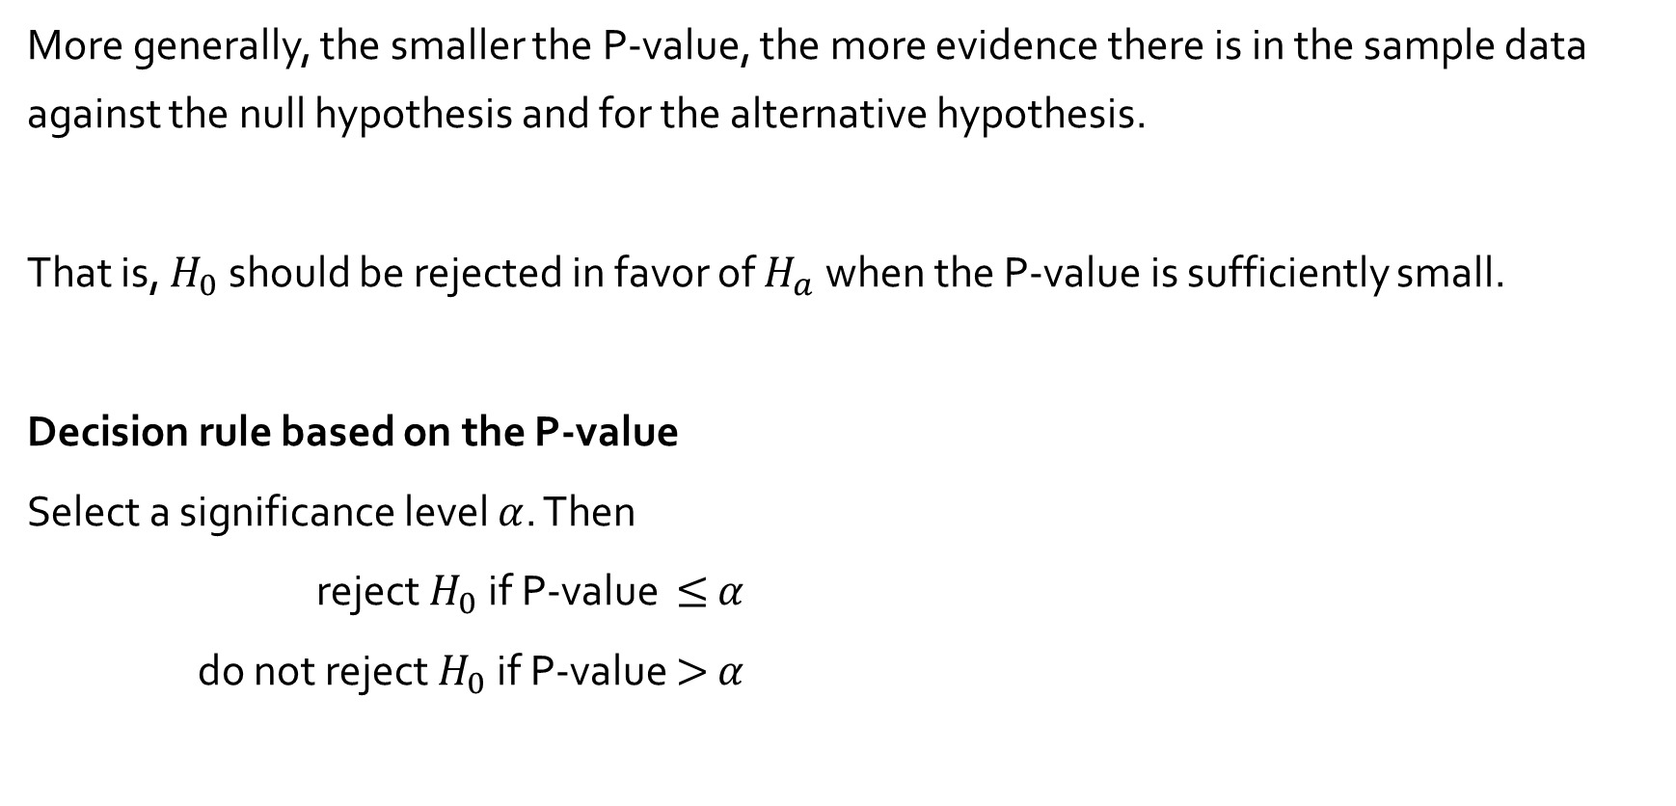
More generally, the smaller the P-value, the more evidence there is in the sample data against the null hypothesis and for the alternative hypothesis.
That is, $H_{0}$ should be rejected in favor of $H_{a}$ when the P-value is sufficiently small.
Decision rule based on the P-value
Select a significance level $α$. Then
reject $H_{0}$ if P-value $≤$ $α$
do not reject $H_{0}$ if P-value $>$ $α$

Slide 5
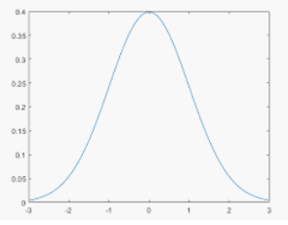
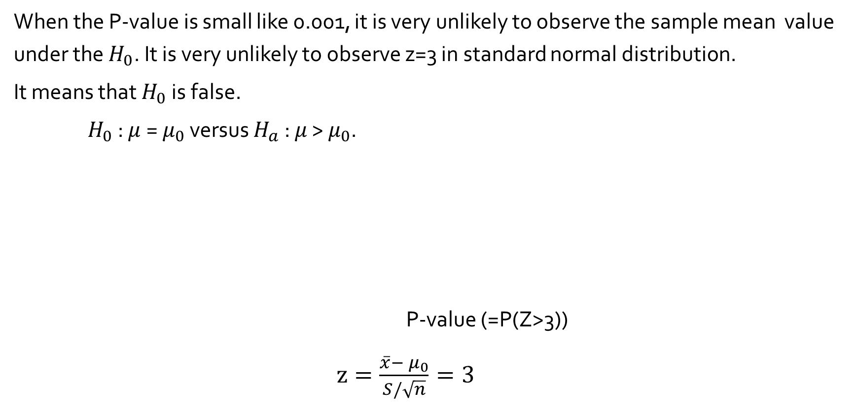
When the P-value is small like 0.001, it is very unlikely to observe the sample mean value under the $H_{0}$. It is very unlikely to observe z=3 in standard normal distribution.
It means that $H_{0}$ is false.
$H_{0}$ : $μ$= $μ_{0}$ versus $H_{a}$ : $μ$ > $μ_{0}$.
P-value (=P(Z>3))
$z=\frac{\overline{x}−{ μ}_{0}}{S/\sqrt{n}}=3$
0.001

Slide 6
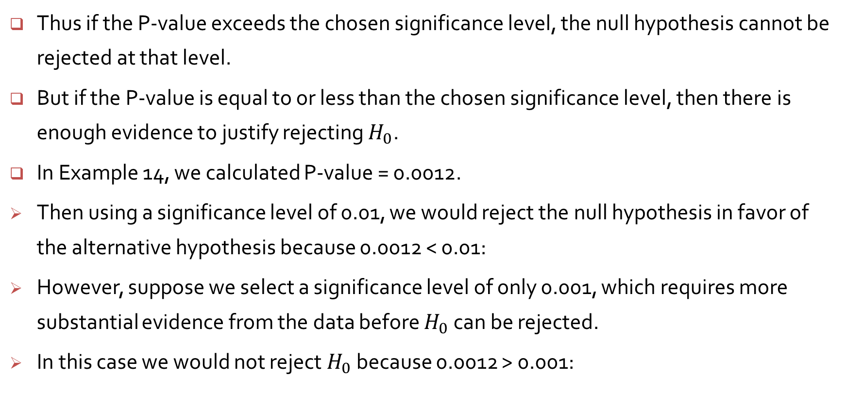
Thus if the P-value exceeds the chosen significance level, the null hypothesis cannot be rejected at that level.
But if the P-value is equal to or less than the chosen significance level, then there is enough evidence to justify rejecting $H_{0}$.
In Example 14, we calculated P-value = 0.0012.
Then using a significance level of 0.01, we would reject the null hypothesis in favor of the alternative hypothesis because 0.0012 < 0.01:
However, suppose we select a significance level of only 0.001, which requires more substantial evidence from the data before $H_{0}$ can be rejected.
In this case we would not reject $H_{0}$ because 0.0012 > 0.001:

